Slide 1
Homelessness Simulation
Group 19 - Mitchell Jones, Dylan Brunelle, Dua’a Hussein, Daniel Kim

Slide 2
Recap
The Chicago Coalition of the Homeless (CCH) is a non-profit dedicated to assisting the homeless with the goal of eradicating homelessness in Chicago
Proposal:
A simulation that emulates homelessness based off real experiences of the homeless to encapsulate the strain, stress, and impacts that homelessness has on individuals.
Goal ⇒ Change misconceptions about homelessness and encourage donations to the CCH to assist the homeless.

Slide 3
Design Goals
Accuracy Priority
Main Priority ⇒ accuracy with regards to the experiences and making sure that it is not romanticizing, sugarcoating, or demeaning towards homelessness
Homelessness⇒ serious issue that needs to be addressed, preserve dignity and respect for those who have gone through it
Speed Balancing
Recreating a complex situation is going to require many working parts
Speed needs to be watched in order to make a mostly seamless simulation

Slide 4
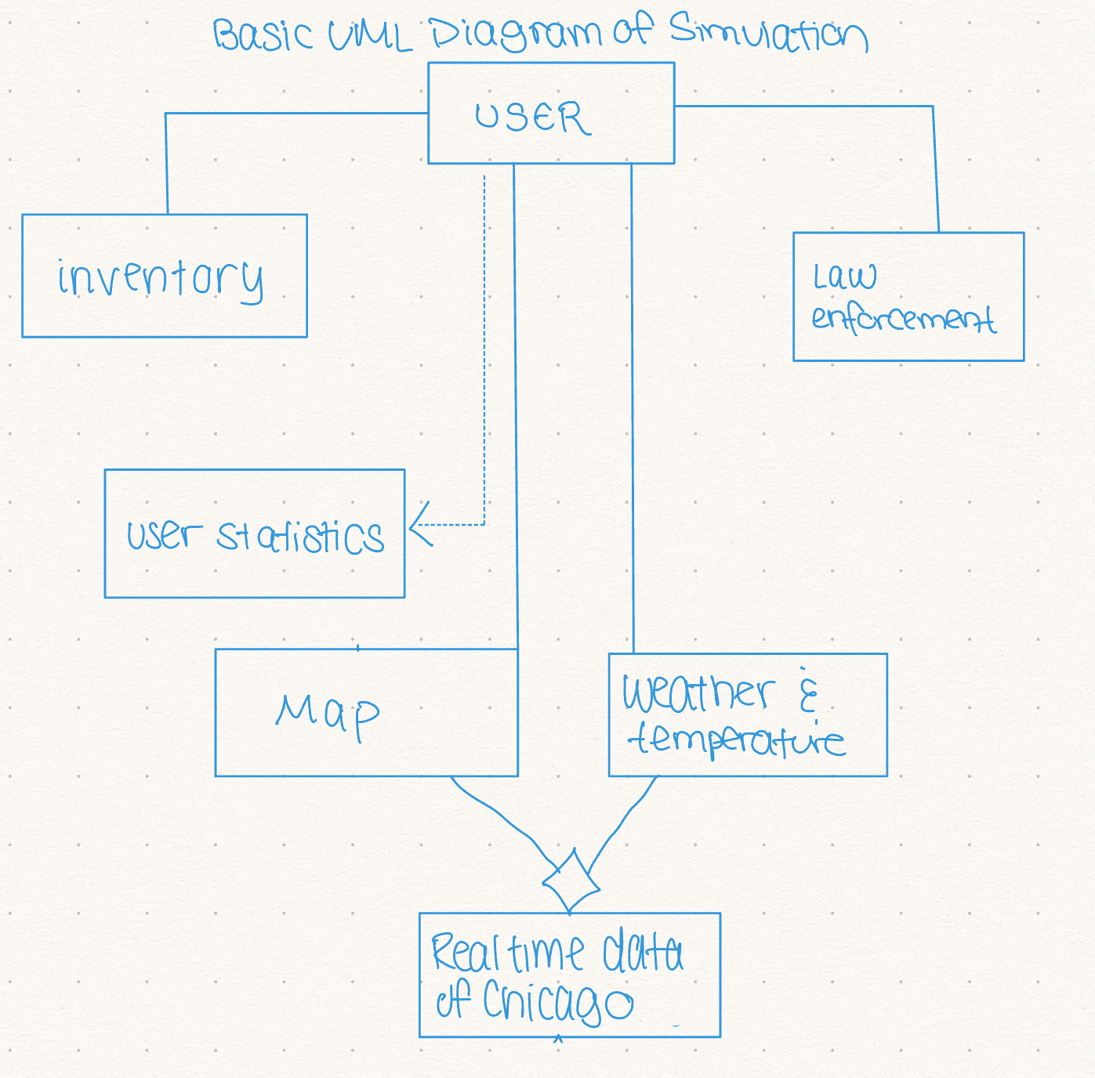
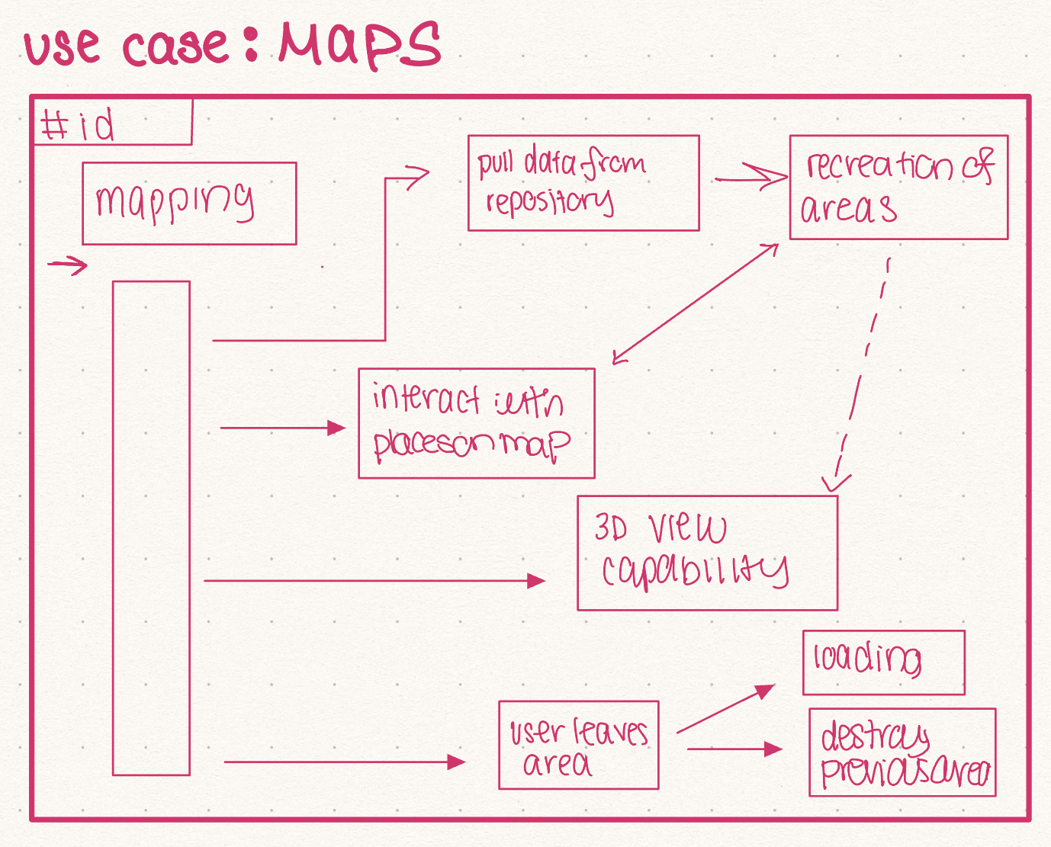
Proposed System Design
Prototype use case and UML diagrams were created to visualize what the simulation will need
Left: Basic UML diagram of broad ideas for classes
Right: Prototype sequence diagram for maps

Slide 5
Proposed System Architecture
Repository
Map and Environmental Hazards such as weather and temperature will be derived from real world data of the Chicagoland Area to ensure that accuracy is achieved
Event Driven
Many of the situations that may occur that can affect the user’s stats and health may often be randomized, so having an Event-Driven structure that will be able to handle the more complex nature of the simulation

Slide 6
Additional Design Choices
The simulation files should be contained in a way that should not interact with files on the system that it is running on, in order to make access control secure
For software control, the simulation should be able to run comfortably on the platforms it was created for without noticeable differences between different systems
Boundary Conditions ⇒ saving in the events of a crash, maintaining the configuration of the files without losing data or breaking the rest of the program

Slide 7
Potential Design Patterns
Singleton
To ensure that only one instance of the simulation is up at a time on a device
Common design pattern for games and simulations
The simulation will exist as a single “game loop,” presenting the user with a choice, and responding to input.
Composite Pattern
User will interact with various types of scenario that largely behave the same way
Scenarios will be composed of mostly the same “game” elements. i.e. events, choices.

Slide 8
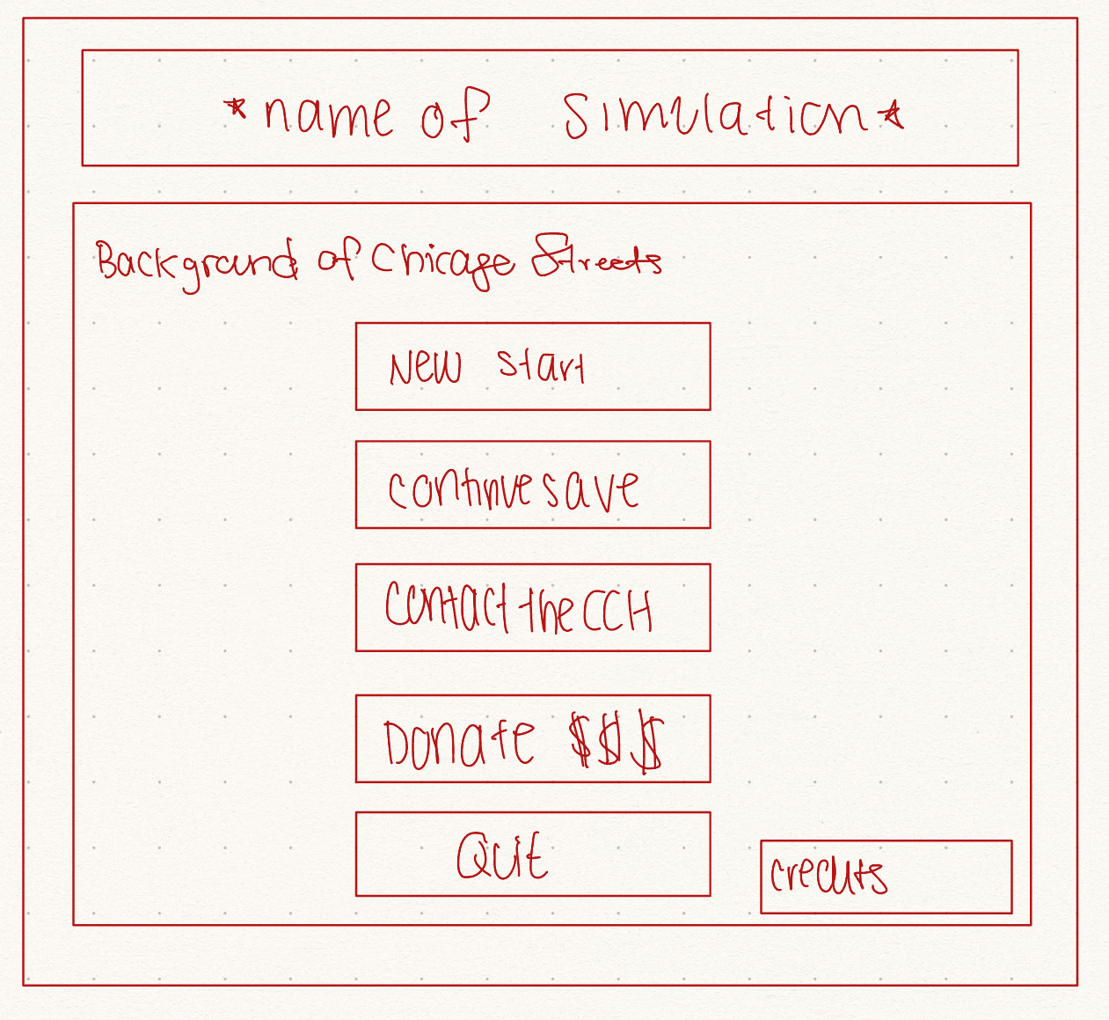
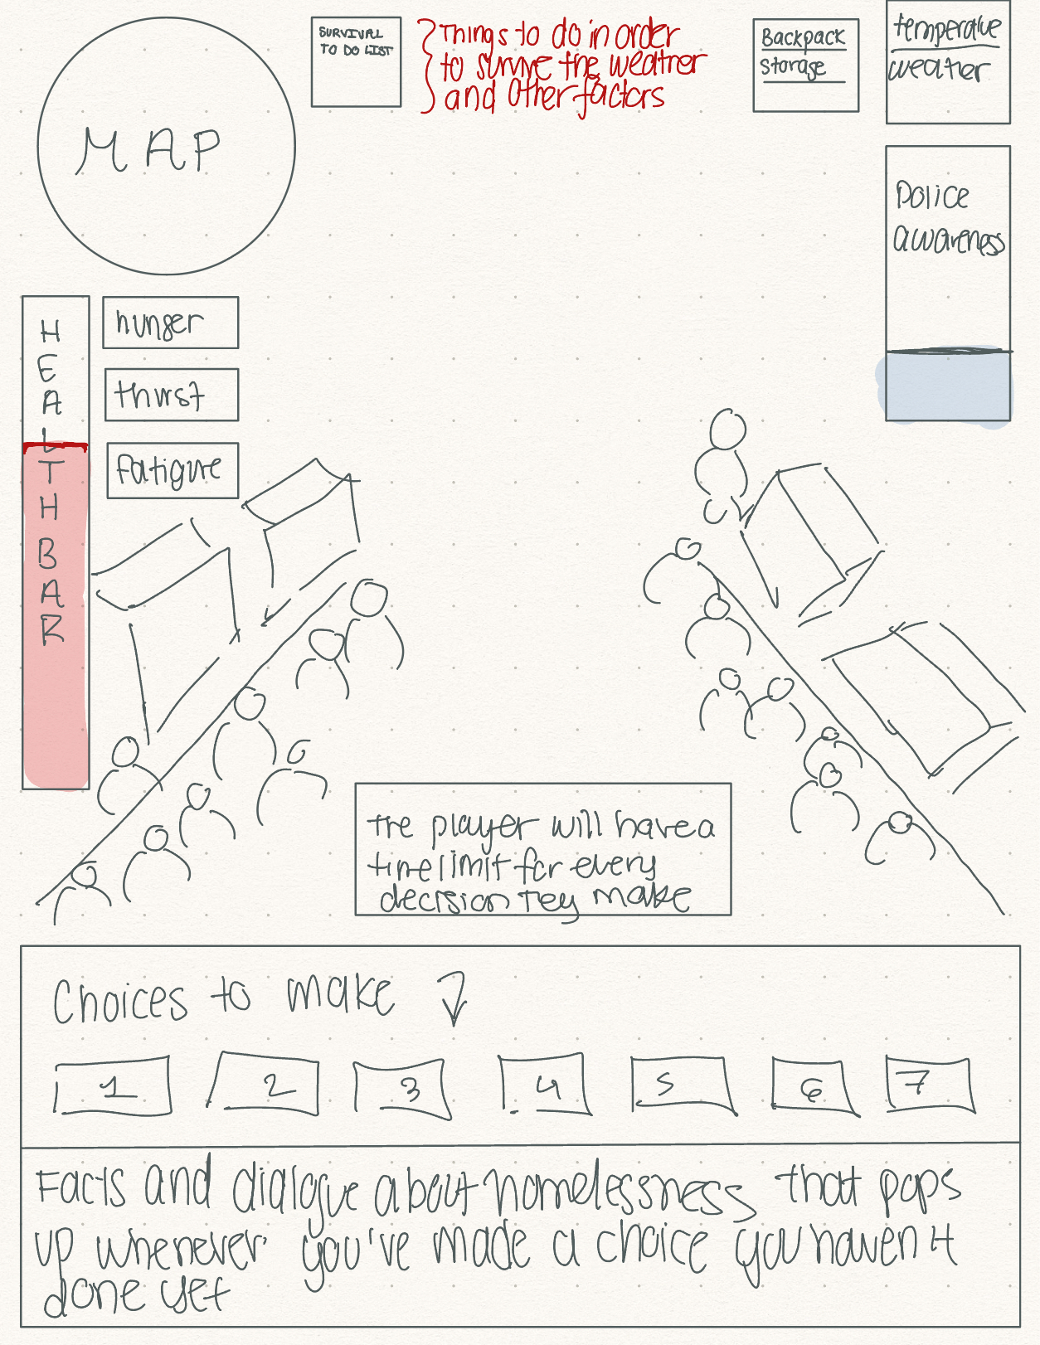
User Interface
Opening Screen
During Simulation

Slide 9
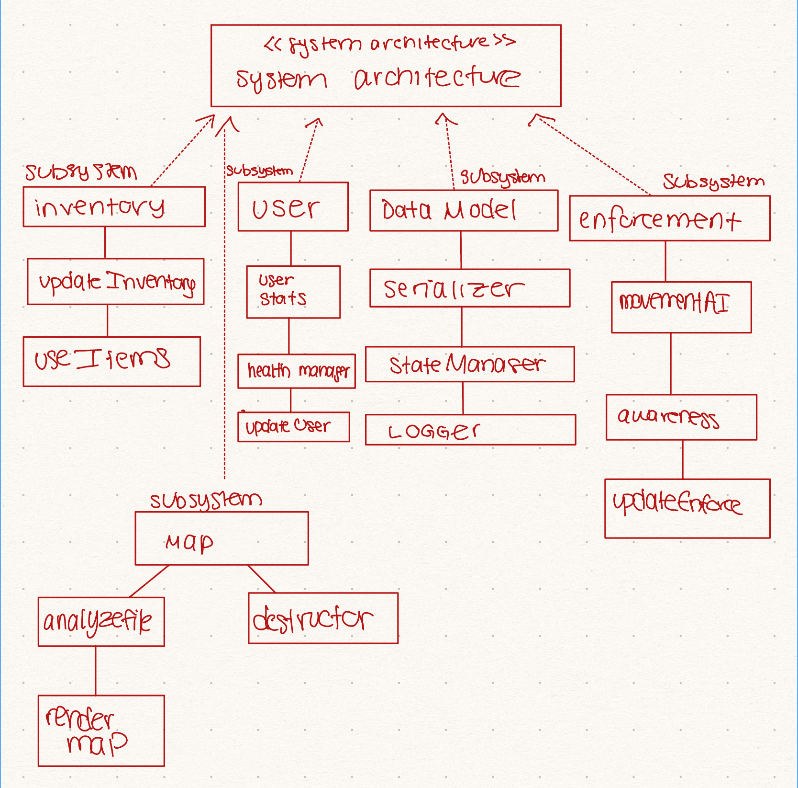
Projected Subsystems
Inventory Subsystem
First Discovery and Tracking of items
Saving and usage of items
Map Subsystem
Analysis of real maps of the Chicago
Rendering of map to traverse
Weather Subsystem
Analysis of data of Chicago weather and temperature
Randomization of weather in game
Scenario Subsystem
Generates scenarios using data from other subsystems
Choices made will update player/inventory data
Serialization and Saving Subsystem
Saving, loading, and configuration of the simulation

Slide 10
Credits and Citations
[1] “How much does it cost to make a game?,” Auroch Digital, https://www.aurochdigital.com/blog/2021/8/19/how-much-does-it-cost-to-make-a-game (accessed Sep. 30, 2023).
[2] “How Much Does It Cost To Develop A Game,” Rocket Brush Studio, https://rocketbrush.com/blog/how-much-does-it-cost-to-develop-a-game (accessed Sep. 30, 2023).
[3] “How Long Does it Take to Make a Video Game?,” ARC Academy, https://arc.academy/how-long-does-it-take-to-make-a-video-game/ (accessed Sep. 30, 2023).
[4] A. Crivello, “Game Engines,” G2, https://www.g2.com/glossary/game-engines-definition (accessed Sep. 30, 2023).
[5] “About Us,” Chicago Coalition for the Homeless, https://www.chicagohomeless.org/about/ (accessed Sep. 30, 2023).
[6] “Low end desktops and PCs dominate the market: report,” Tech Monitor, https://techmonitor.ai/technology/low-end-and-pcs-dominate-the-market-report-091112 (accessed Sep. 30, 2023).
[7] “Desktop Windows Version Market Share United States of America,” StatCounter Global Stats, https://gs.statcounter.com/windows-version-market-share/desktop/united-states-of-america (accessed Sep. 30, 2023).
[8] “Desktop Windows Version Market Share Worldwide,” StatCounter Global Stats, https://gs.statcounter.com/os-version-market-share/windows/desktop/worldwide (accessed Sep. 30, 2023).
[9] “Operating System Market Share Worldwide,” StatCounter Global Stats, https://gs.statcounter.com/os-market-share (accessed Sep. 30, 2023).
[10] “Operating System Market Share United States of America,” StatCounter Global Stats, https://gs.statcounter.com/os-market-share/all/united-states-of-america (accessed Sep. 30, 2023).
[11] “Language Access”, City of Chicago, https://www.chicago.gov/city/en/depts/mayor/supp_info/office-of-new-americans/language-access.html (accessed Oct. 27, 2023).
[12] “How to Fix Input Lag,” Intel, https://www.intel.com/content/www/us/en/gaming/resources/how-to-fix-input-lag.html (accessed Oct. 26, 2023).
[13] “Game Industry Standards,” IGDA, https://igda.org/resourcelibrary/game-industry-standards/ (accessed Oct. 27, 2023).

